Slide 1
HarbourMaster

Slide 2
1st sprint

Slide 3
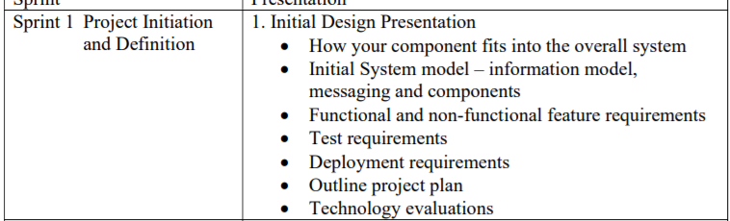
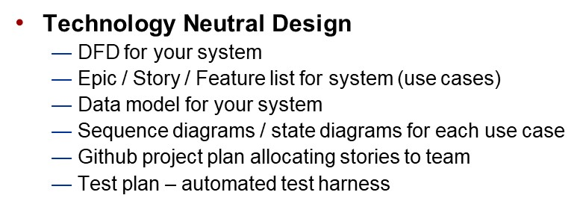
Topics

Slide 4
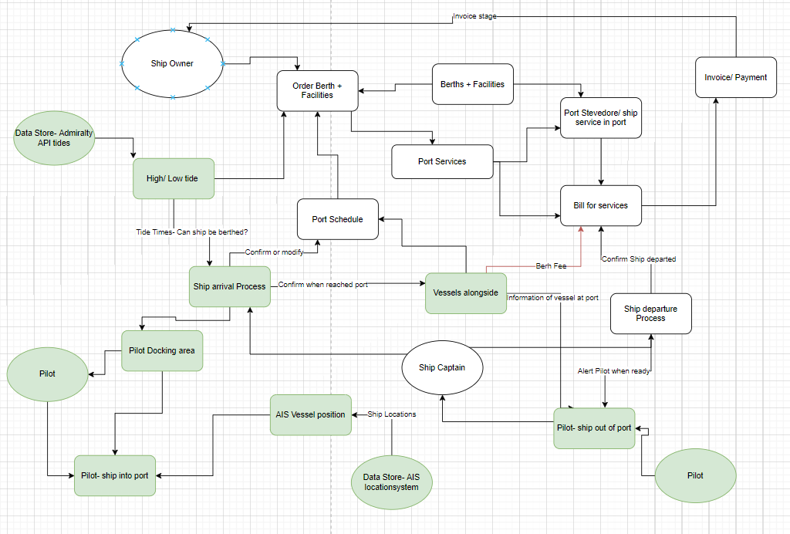
DFD

Slide 5
EPIC/ STORY/ FEATURE
Epic- entire DFD
Further Epic- highlighted green, our area/ which systems we interact with.
Story- each of the nodes (ship arrival process/ Ship departure process)
Features- capabilities of those nodes

Slide 6
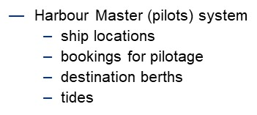
Our System
Ship locations -Detected actual AIS location of ship.
Bookings for Pilotage- Rest Client interface for Captain/ Owner
Destination Berths- access port schedule (Port owners ABP system) and update ‘vessel alongside’
Tides- Admirality API to access high/ low tides

Slide 7
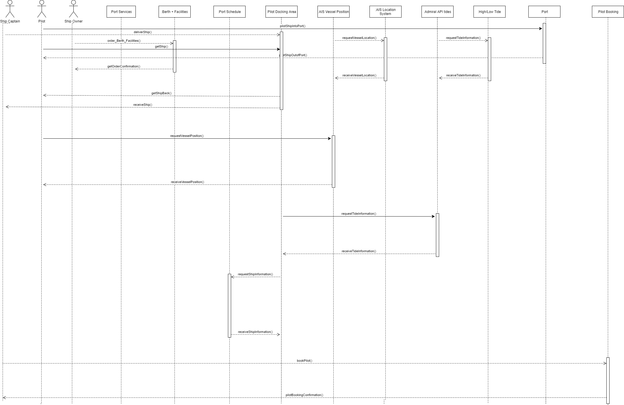
Sequence Diagram

Slide 8
How we interact with the other systems
We need to be able to access the Port Schedule so that we can confirm/ modify the schedule as the ships are being piloted in/out of berthing.
We need to know whether the ship is on schedule, has shown up so that we can get the Pilot over to the vessel.
We need to be able to identify the vessel (UUID + captain etc)
We also need to be able to have information available about the ship ( ship info- LOA, number of passengers etc)
---
The Tidal API that is a part of our system will need to be used in the berth booking schedule for the port owners as we can only take in large vessels at high tide.

Slide 9
How our system fits overall/ SHIP ARRIVAL
We are heavily reliant on then Port Owner ABP system of the port schedule in the grand scheme of things –
When a Berth has been ordered* (Berthing reference – provide berth destination to Pilot)
When ship arrives and has a berthing reference- we then use vessel position (AIS?) or pilot-docking area for pilot to board the ship and berth the ship
-We then confirm when the ship has been docked (vessel alongside port)
Berthing time- port owners (reliant on our Tidal API)
Destination Berth- reliant on schedule/ where the ship will fit.

Slide 10
How our system fits overall/ SHIP dEPARTURE
When the ship is ready to depart, we need to be contacted/ made aware after the services have been carried out. ( amended schedule set to ‘awaiting departure’ which will flag this up to our pilots)
We then update schedule when a ship has been moved out of the dock so that it can be moved to a ‘completed’ state and then is no longer shown on a ‘live’ list of ships.

Slide 11
Initial USE CASES identified
ReST interface which allows for ship captain/owner to book a berthing after ship has been scheduled.
Able to pull and check a ship UUID & AISand location which allows pilots to identify the boat they need to board and dock/berth.
Tidal API needs to return 6-day cycle of future high and low tides and return Boolean high/ low which is then used by the port schedule (make sure larger ships cannot be booked through on low tide)
---
Bookings for Pilotage – Appointment scheduling
Destination Berths- Appointment scheduling
(mentioned in previous slides)

Slide 12

TEST PLAN/ HARNESS
Testing to make sure each use case works independently.
Use dummy data for those that rely on other teams’ API.

Slide 13
non functional feature req
Banking (berthing fees) we may add in ability for this to be paid to us separately as a sub-service, but this will likely be added to the invoice sent to the ship owner.
Extensive admin privileges – Access to captains/ owners/ port owners and other services will need different levels of access.
Ship exceptions*
Does the ship need to be piloted? (Yachts/ small boats)

Slide 14
Classifying if a ship needs to be piloted (booking schedule)
Classification- (taken from soton port)
If a ship has 12 passengers & ship length is more than 20m OR
If the ship length is greater than 61m then Pilot required
(Boolean Y/N to check against AIS/ Ship identity information )
(IF STATEMENT)

Slide 15



Technology evaluations
Github actions/ joint environment/ continuous deployment to cloud.
Docker container so other people can access.
Junit- testing working with Maven
Jersey/ Spring TBD
MYSQL- database
JSP’s for frontend.

Slide 16
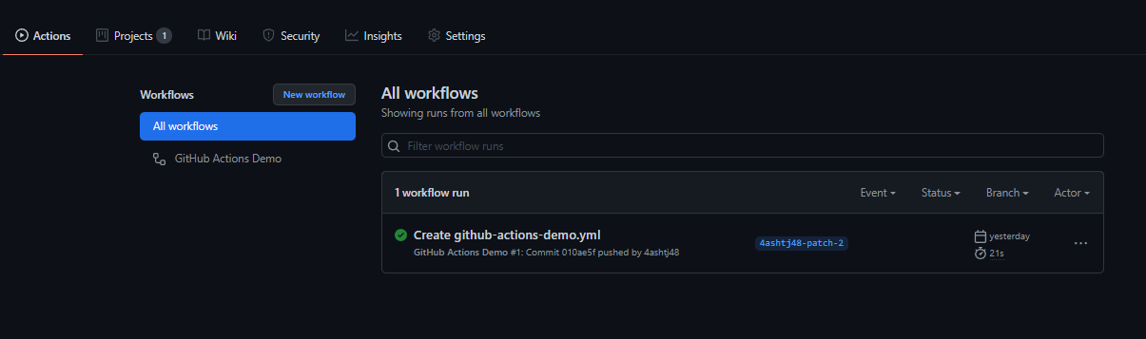
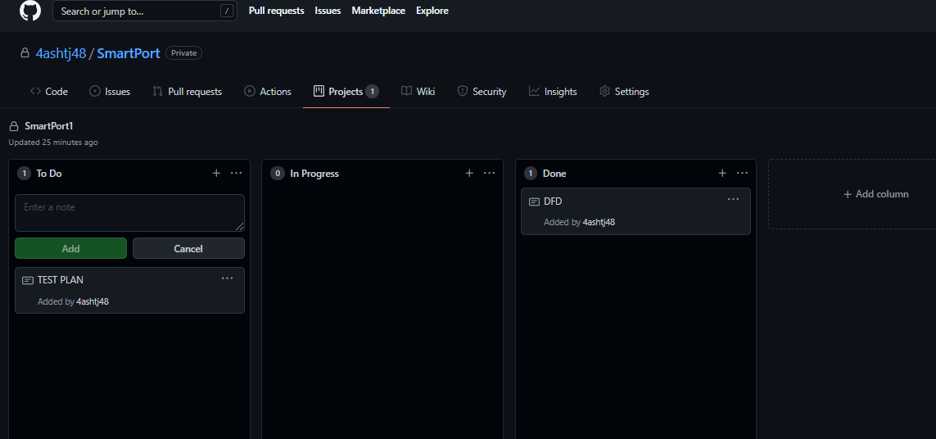
Github project/ actions

